Slide 1
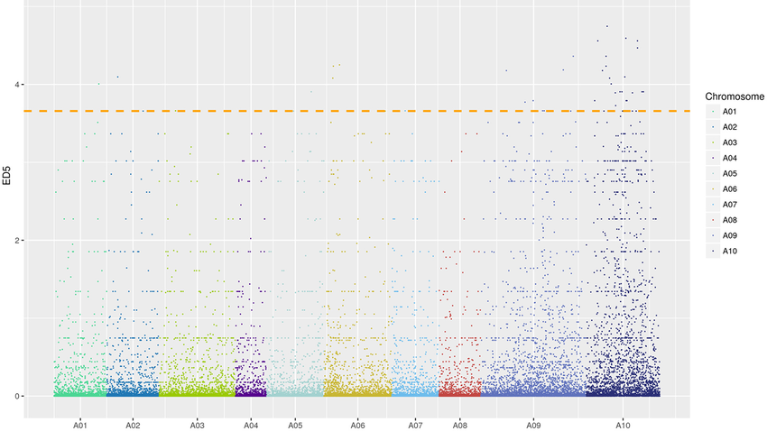
SNV Calling Pipeline with Snakemake (chr20)
Meryem Topcu
26 Nov 2026

Slide 2
Project goal
Build a SNV calling workflow using Snakemake & Commit to github
Input: short-read sequencing data from the NA12878 sample and the human chromosome 20 reference (chr20.fa).
Output: VCF file containing the called variants for NA12878 on chr20.

Slide 3
Data set
Sample
NA12878: human genome sample.
Raw Data
Sequencing reads: Paired-end FASTQ
Files: SRR622461_1.fastq.gz SRR622461_2.fastq.gz
Source: NCBI SRA
Total size: ~7–8 GB (depending on compression)
Reference Genome
Chromosome: Homo sapiens chr20
File: chr20.fa
Source: Ensembl (GRCh38)
Why chr20?
Small size → fast workflow tests
Contains real polymorphisms → good for variant calling

Slide 4
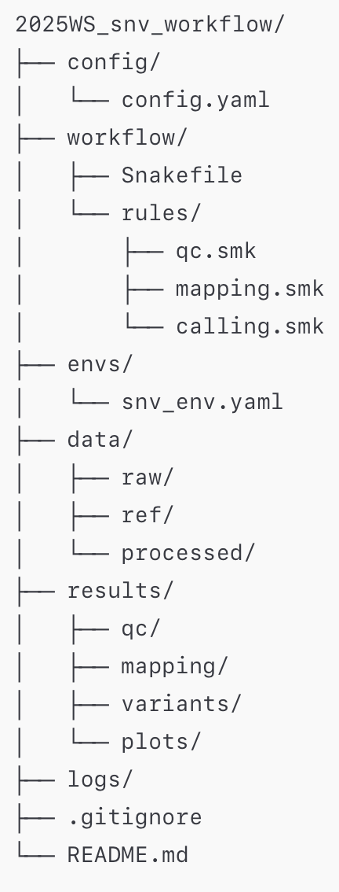
config.yaml → Stores sample IDs, file paths, and global parameters.
Snakefile → whole workflow;
qc.smk → the fastqc rule for raw read quality control.
mapping.smk →index_reference, bwa_map, sort_bam, index_bam.
calling.smk → call_variants and related steps for VCF generation.
snv_env.yaml→ Defines the conda environment so the workflow is reproducible.

Slide 5
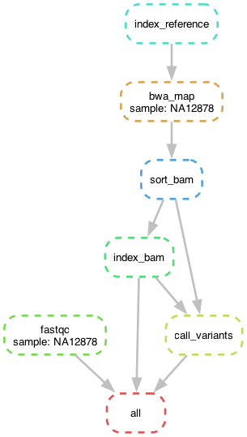
Workflow Rule Summary
Rule Name | Input Files | Output Files | Short Description
fastqc | data/raw/{sample}.fastq.gz | results/qc/{sample}_fastqc.html results/qc/{sample}_fastqc.zip | Runs quality control on raw reads using FastQC.
index_reference | data/ref/chr20.fa | chr20.fa.amb, .ann, .bwt, .pac, .sa | Builds BWA index files for the chromosome 20 reference FASTA.
bwa_map | FASTQ + chr20.fa + BWA index | results/mapping/{sample}.bam | Aligns sequencing reads to chr20 using BWA and produces unsorted BAM.
sort_bam | {sample}.bam | {sample}.sorted.bam | Sorts BAM by genomic coordinates (required for variant calling).
index_bam | {sample}.sorted.bam | {sample}.sorted.bam.bai | Creates BAM index for efficient random access.
call_variants | Sorted BAM + BAM index + chr20.fa | {sample}.bcf, {sample}.vcf.gz | Calls variants using bcftools mpileup + call. Produces final VCF.
all | (final targets) | FastQC HTML, sorted BAM index, VCF.gz | Snakemake final rule: workflow ends when all targets exist.
Notes:
“From raw sequencing reads to a variant-containing VCF: each step transforms the data into a more structured, interpretable form.”
Proje çıktıları:
QC
results/qc/NA12878_fastqc.html
results/qc/NA12878_fastqc.zip
Mapping
results/mapping/NA12878.sorted.bam
results/mapping/NA12878.sorted.bam.bai
Variant calling
results/variants/NA12878.bcf
results/variants/NA12878.vcf.gz
results/variants/NA12878.vcf.gz.csi

Slide 6
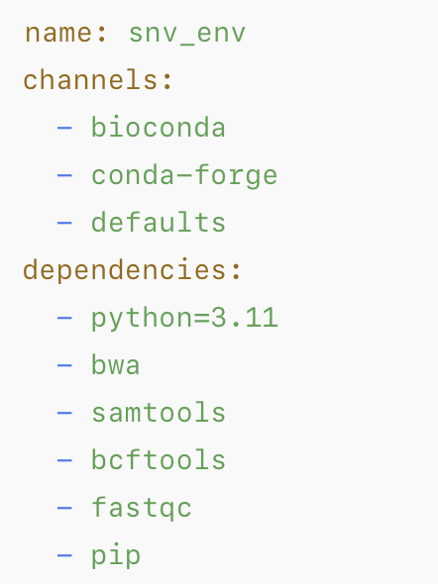
envs/snv_env.yaml
Notes:
“All required tools (BWA, samtools, bcftools, FastQC) are pinned in a conda environment (snv_env.yaml) so the workflow is reproducible on any machine.”

Slide 7
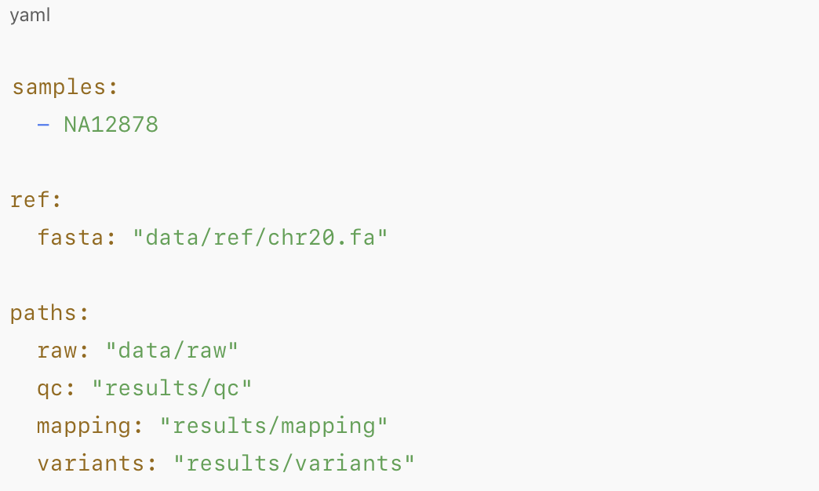
config/config.yaml
Central configuration: sample list, reference genome, and main paths.

Slide 8
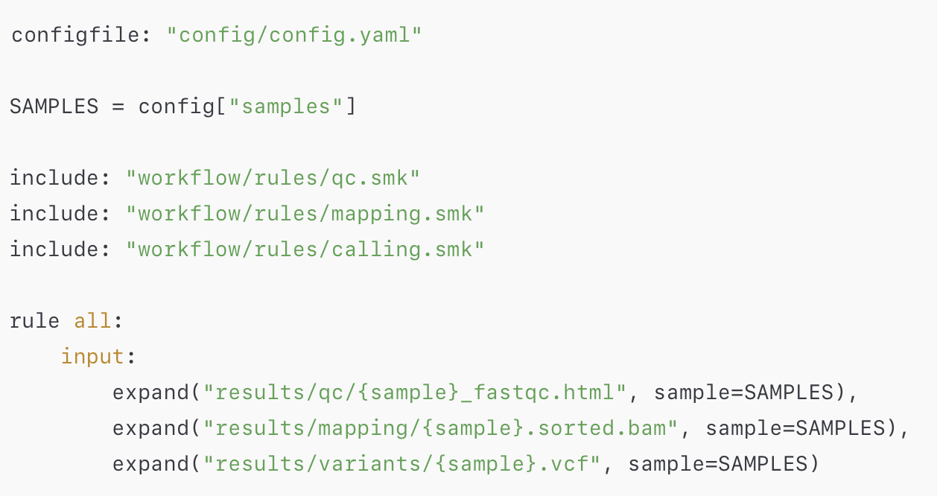
workflow/Snakefile
Notes:
Snakefile includes modular rule files and defines the final targets with rule all.

Slide 9
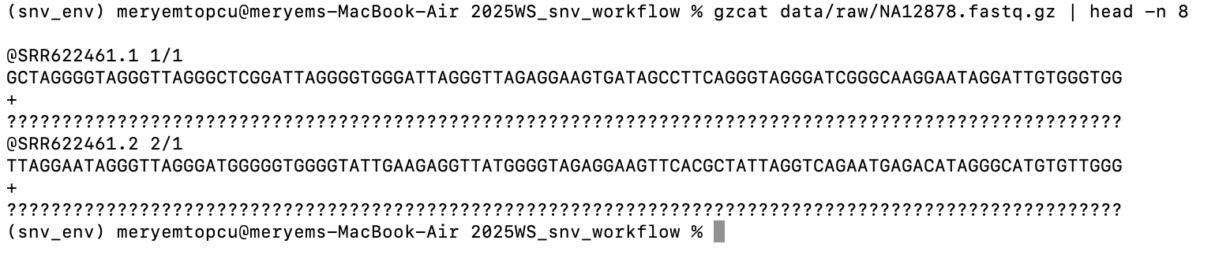
FASTQ

Slide 10
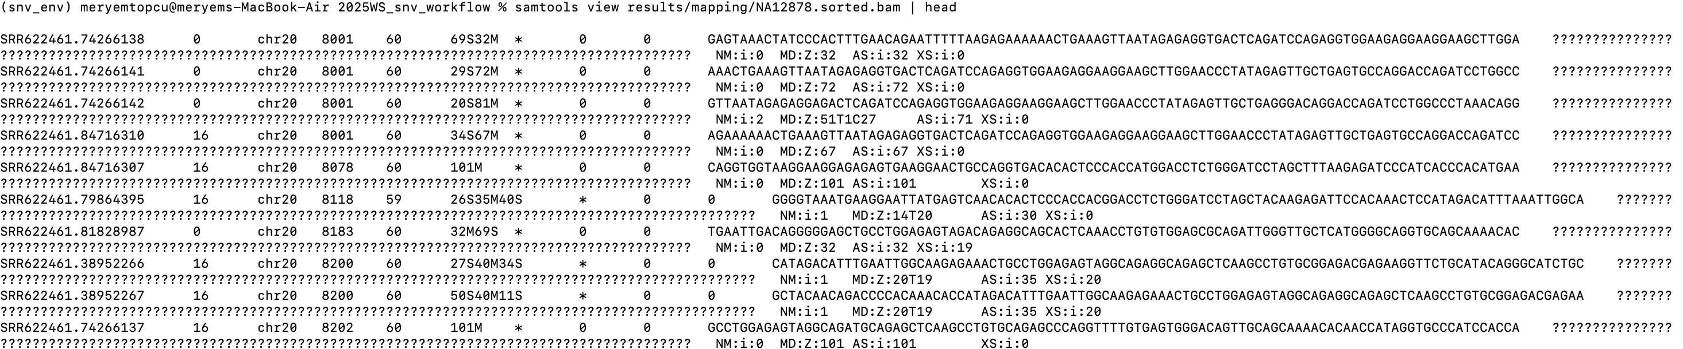
BAM file
Notes:
samtools quickcheck results/mapping/NA12878.bam && echo "BAM OK” → if my BAM file is done content of BAM file samtools view results/mapping/NA12878.sorted.bam | head ls -lh results/mapping/NA12878.sorted.bam.bai
-rw-r--r-- 1 meryemtopcu staff 169K Nov 26 14:28 results/mapping/NA12878.sorted.bam.bai

Slide 11
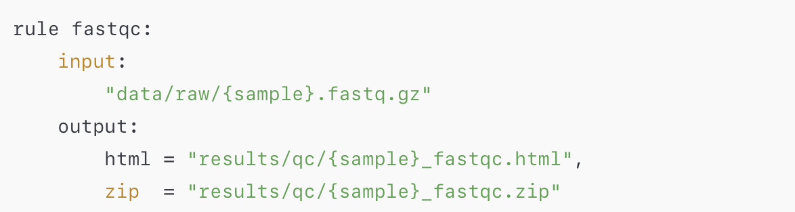
workflow/rules/qc.smk – FastQC
Notes:
Quality control of raw reads with FastQC (per sample).

Slide 12
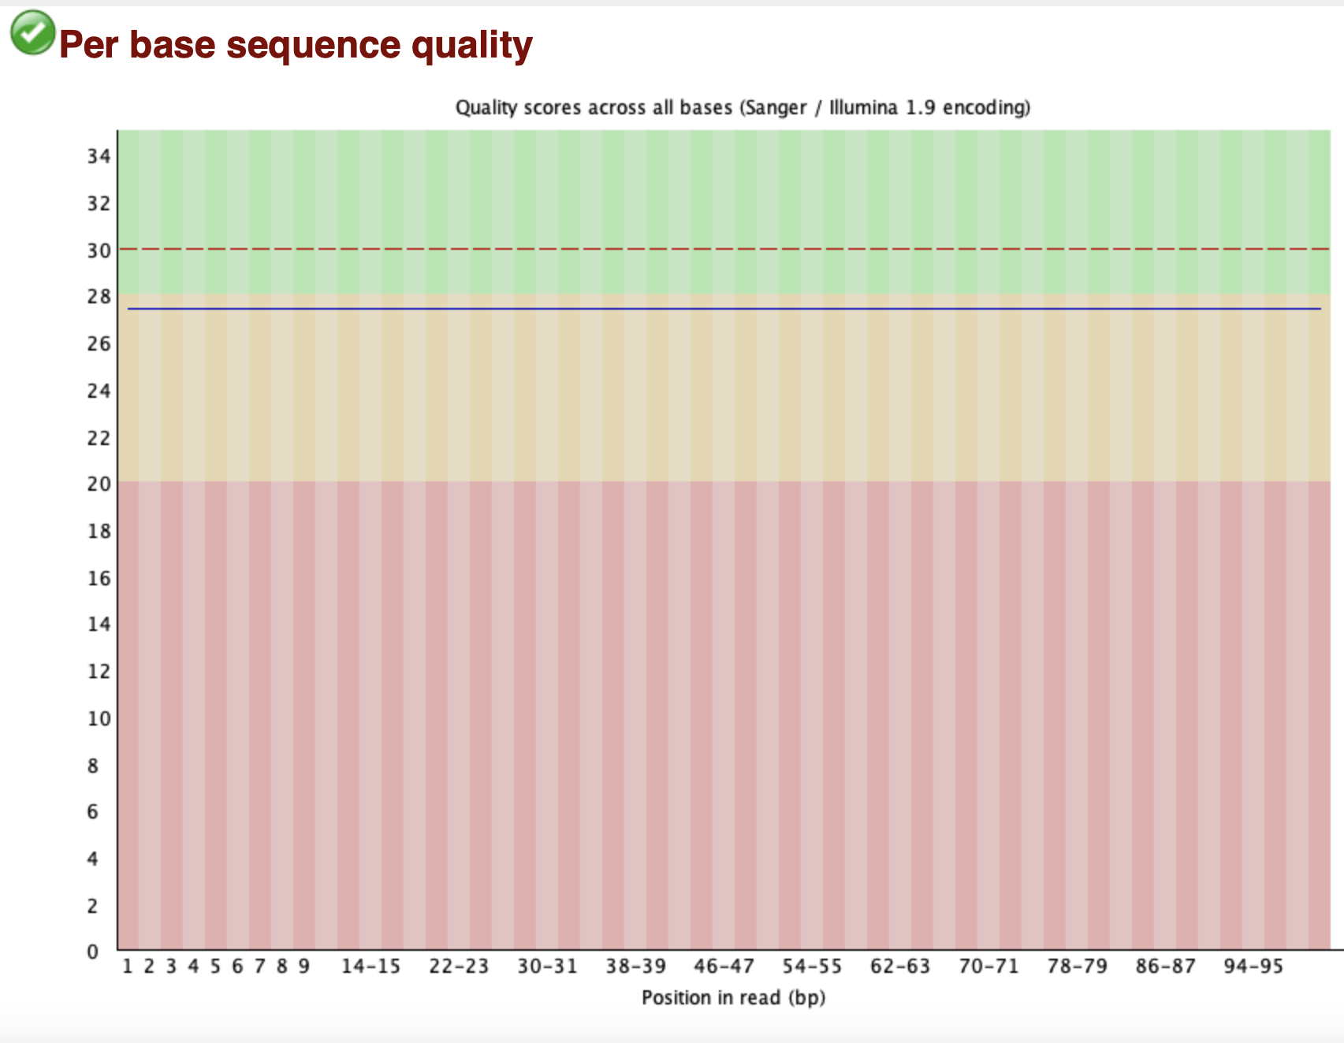
NA12878_fastqc Report
FastQC – Raw Data Quality Assessment
Input: NA12878 FASTQ
Purpose: Evaluate raw read quality before alignment
Result: All major modules show PASS → data is high quality
Next Step: Proceed to BWA alignment
Notes:
FastQC – Raw Data Quality Assessment
Input: NA12878 FASTQ
Purpose: Evaluate raw read quality before alignment
Result: All major modules show PASS → data is high quality
Note: Slight GC deviation is observed but typical for Illumina data and not problematic
Next Step: Proceed to BWA alignment

Slide 13
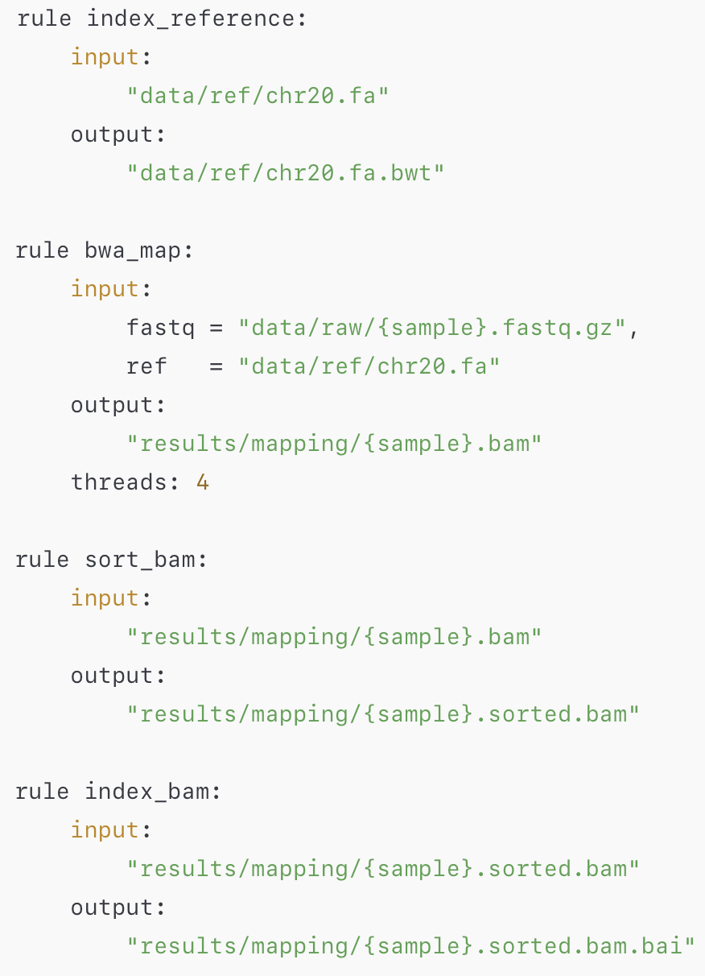
workflow/rules/mapping.smk
Mapping converts raw sequencing reads into an analysis-ready, sorted, and indexed BAM file.
Index_reference
Prepare the reference genome so BWA can use it for alignment.
bwa_map
Align raw FASTQ reads to chr20 and produce an aligned BAM file.
sort_bam
Reorder the BAM by genomic coordinates so downstream tools can read it properly.
index_bam
Create an index for fast, random access to any genomic position.
Notes:
Mapping = FASTQ → BAM
“Reads are aligned to the reference genome and prepared for analysis.”
index_reference: prepare chr20 reference for BWA
bwa_map: align reads to chr20 → BAM
sort_bam: sort BAM by genomic coordinate
index_bam: create BAM index for fast access

Slide 14
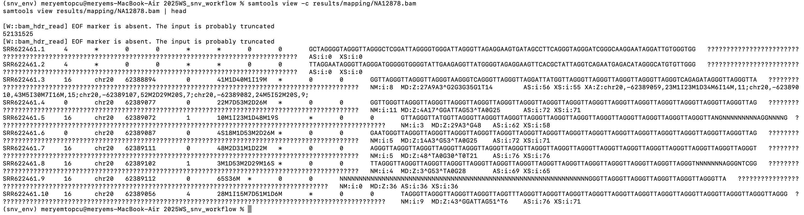
BAM

Slide 15
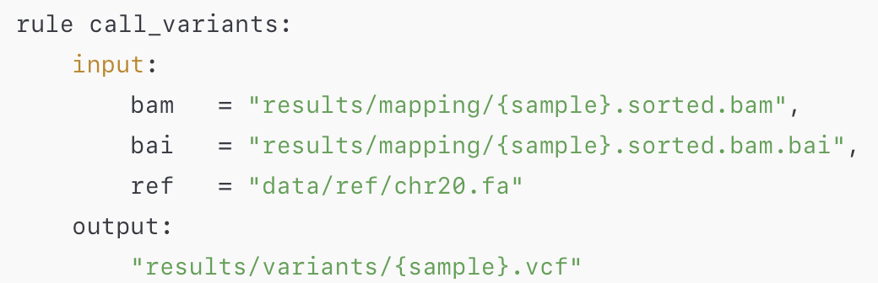
workflow/rules/calling.smk
Calling identifies true differences between the sample and the reference genome and writes them into a VCF.
call
Detect positions that differ from the reference and output them as SNPs/indels in a VCF file.
Notes:
Calling = BAM → VCF
“Differences from the reference are detected and written as variants.”
“Creates a quick-lookup index so tools can jump directly to any position in the genome.”

Slide 16
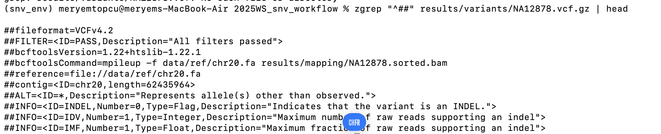
VCF
Notes:
ls -lh results/variants
total 40512
-rw-r--r-- 1 meryemtopcu staff 9.9M Nov 26 14:35 NA12878.bcf
-rw-r--r-- 1 meryemtopcu staff 9.7M Nov 26 14:35 NA12878.vcf.gz
-rw-r--r-- 1 meryemtopcu staff 28K Nov 26 14:35 NA12878.vcf.gz.csi

Slide 17
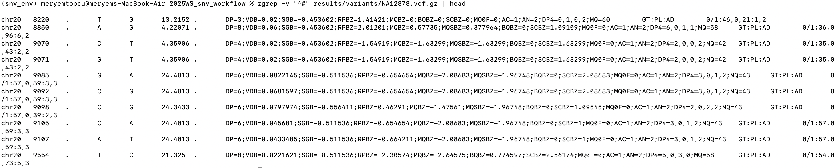
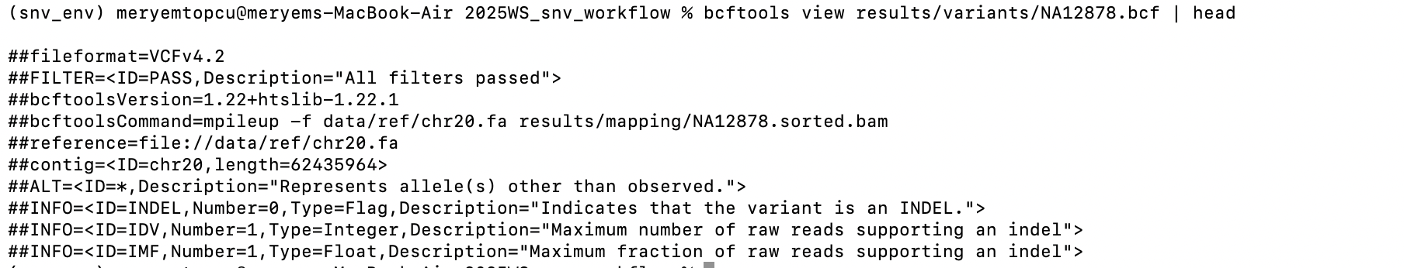
VCF Variant Lines & Number
Notes:
“Our pipeline successfully detected ~248k SNVs/indels on chr20. Each line contains position, reference base, sample base, depth, genotype, and quality metrics.”

Slide 18
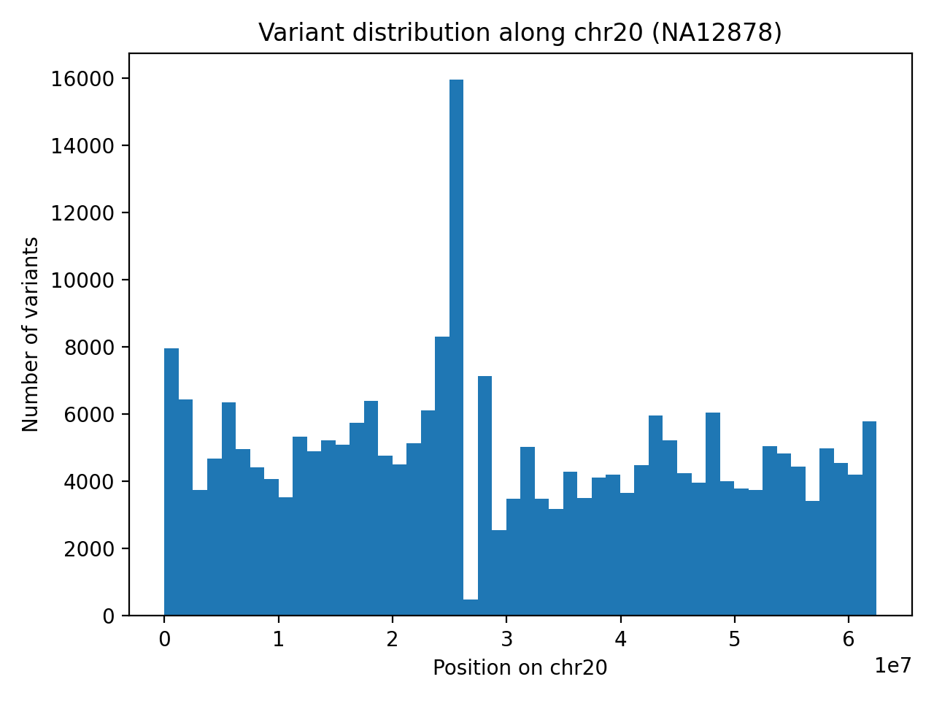
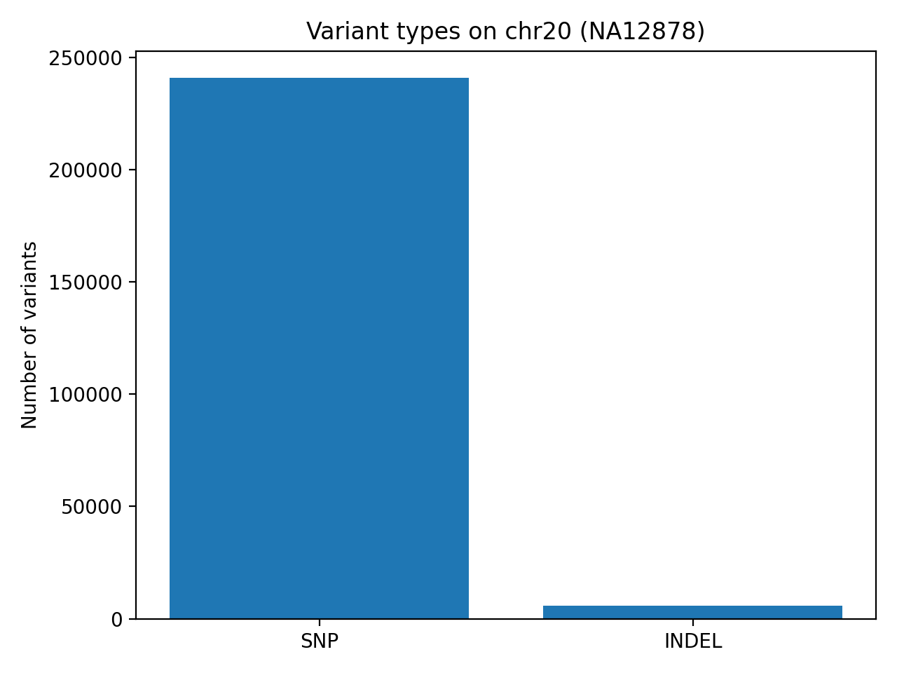
Results
Variants are spread across the entire length of chromosome 20. There’s no extreme clustering—this is what a typical germline genome looks like.
Most variants on chr20 are SNPs, and indels make up only a small fraction — this is the expected pattern for human genomes.

